Slide 1
ITS 4.1 Finance System Improvements
Session 30
Presenter : Brilliant Tleane

Slide 2
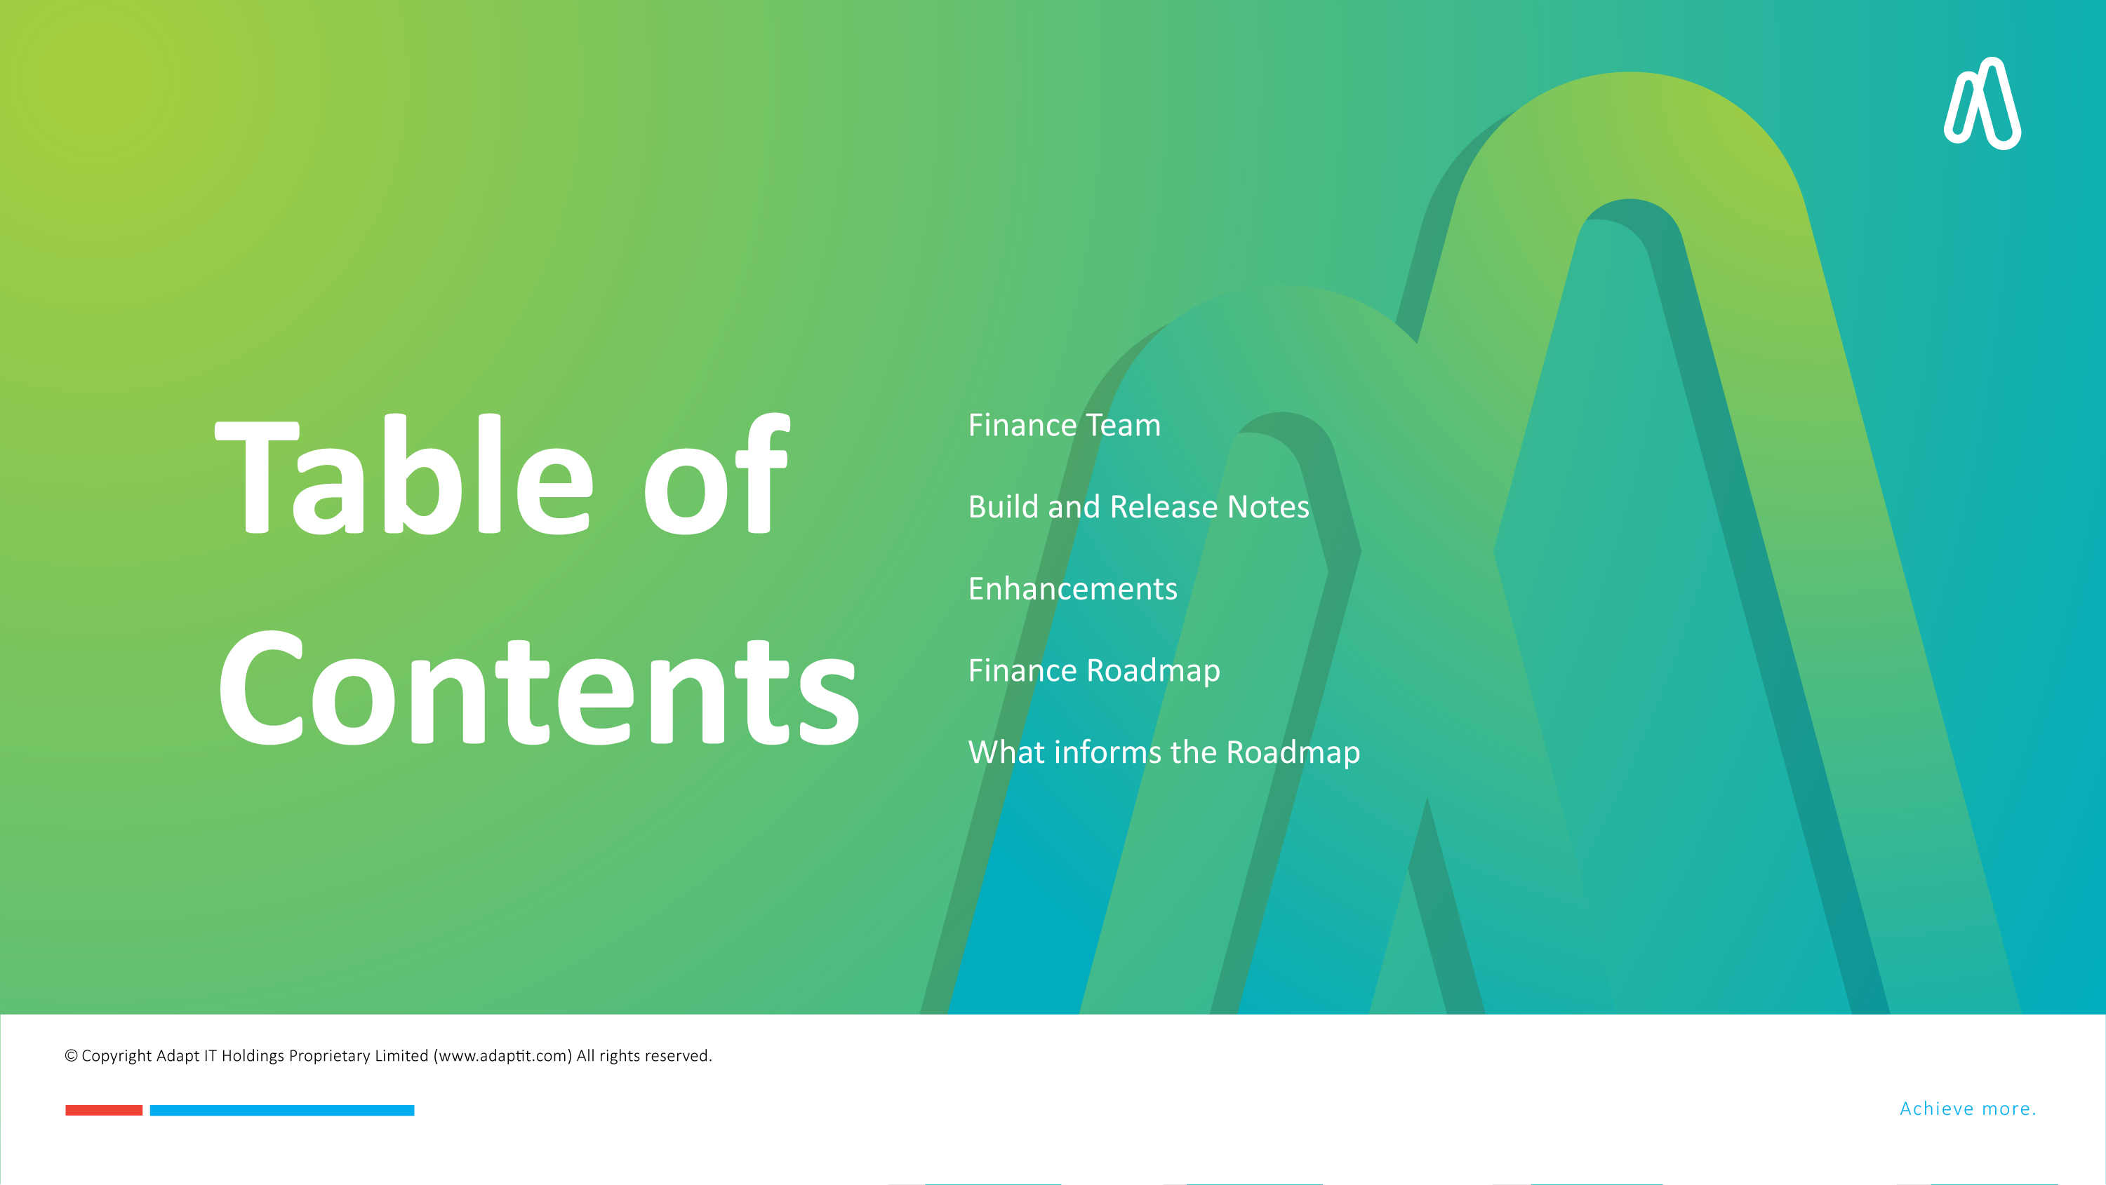
Finance Team
Build and Release Notes
Enhancements
Finance Roadmap
What informs the Roadmap

Slide 3

Finance Team

Slide 4
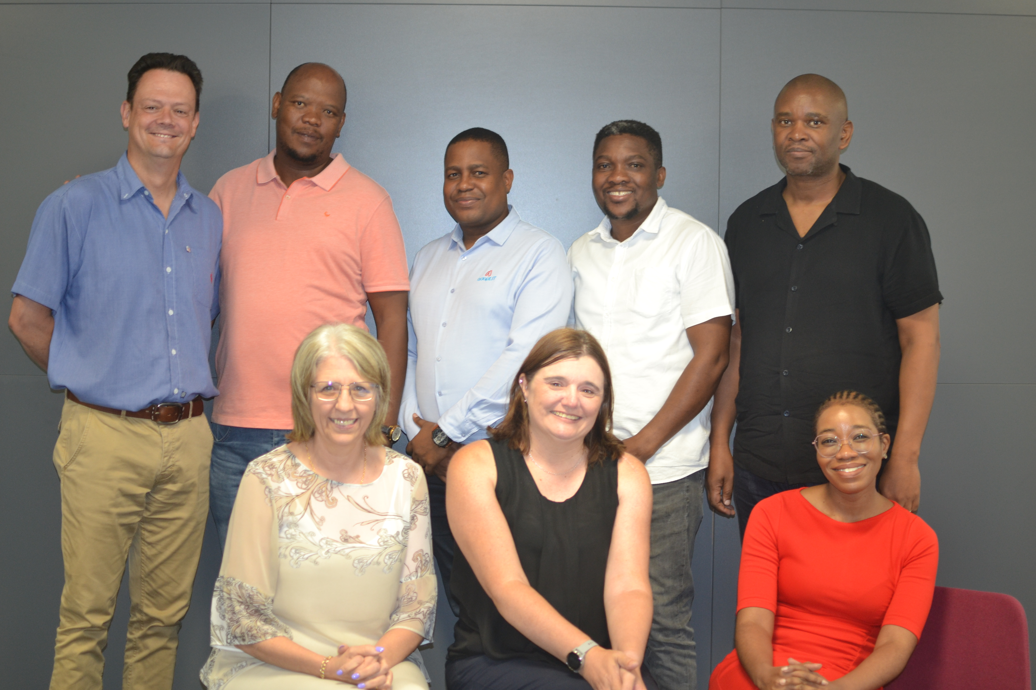
Finance Team
Back Row:
Bernard Mostert, Danny Phalane, Brilliant Tleane, Patson Marandela, Sipho Lupuwana
Front Row:
Linda Burgess, Anelia Terblanche, Sharon Mlangeni
Absent:
Zamamvula Mkhize

Slide 5

Builds and Release notes

Slide 6
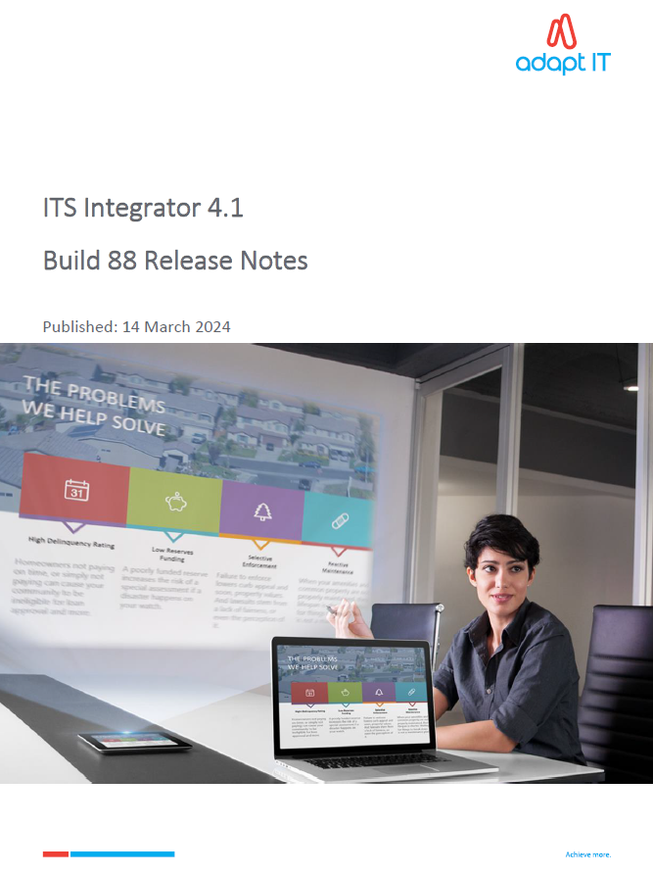
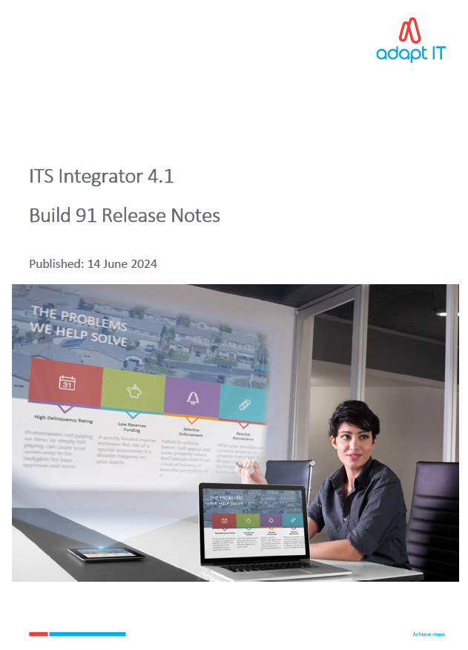
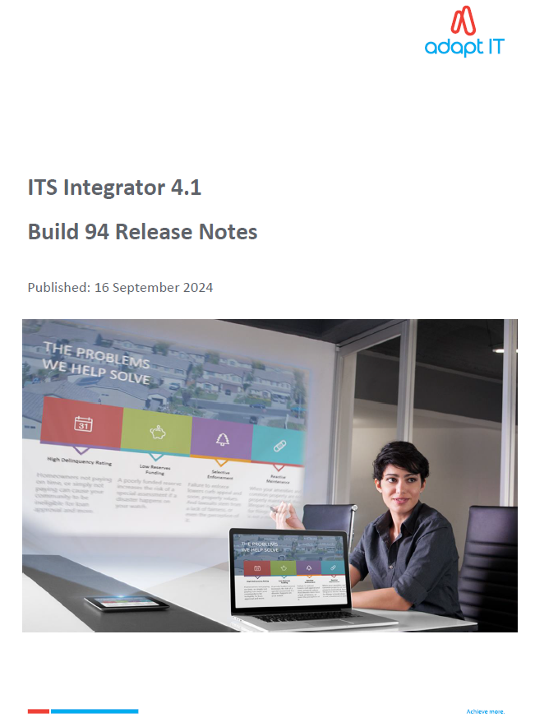
Builds and Release notes

Slide 7

Enhancements

Slide 8

Student Finance Enhancements
Sending Student Statement via WhatsApp
HEPSA
MyGate re-branding to Adumo
Create Student Deposits using Provisional statement
DPO Payment Gateway
Refunds Documents Verification
Batch to update the missing Realex transactions (Irish)
ADF Conversions
Hardening iEnabler Security

Slide 9
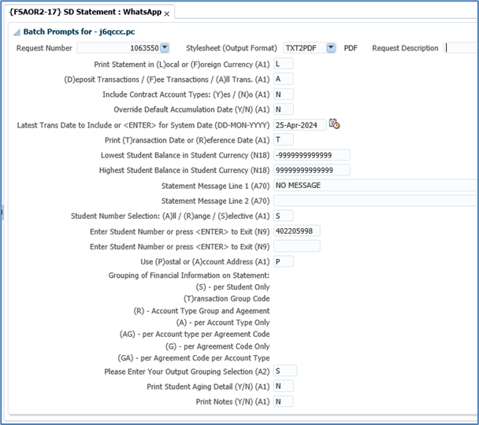

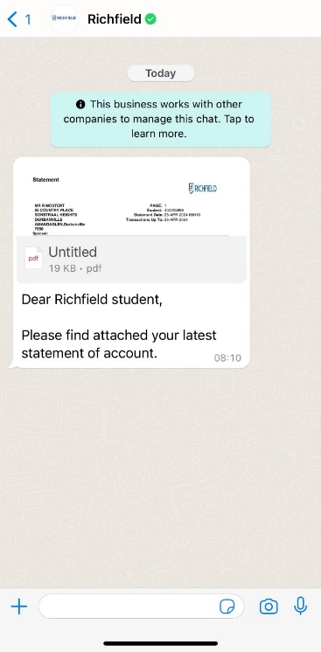
Sending Student Statement via WhatsApp

Slide 10
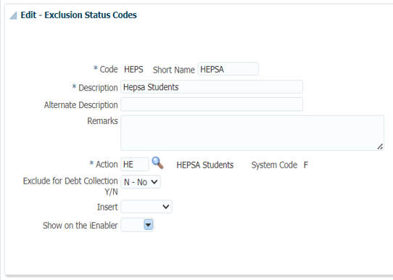
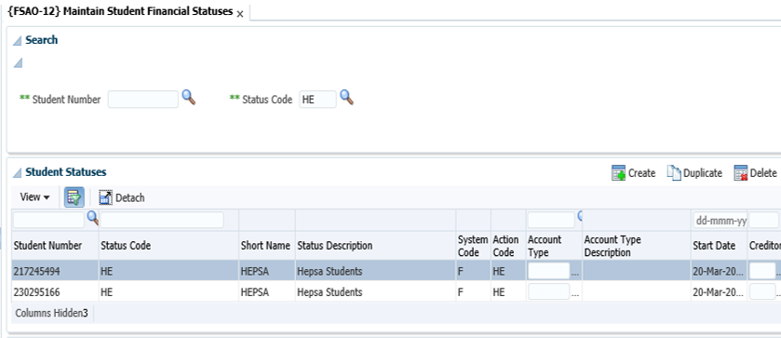
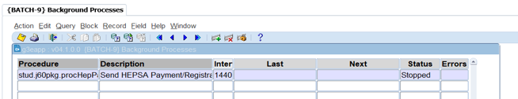
HEPSA

Slide 11
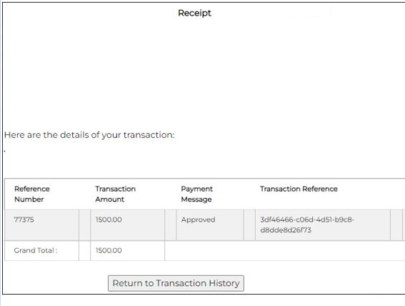
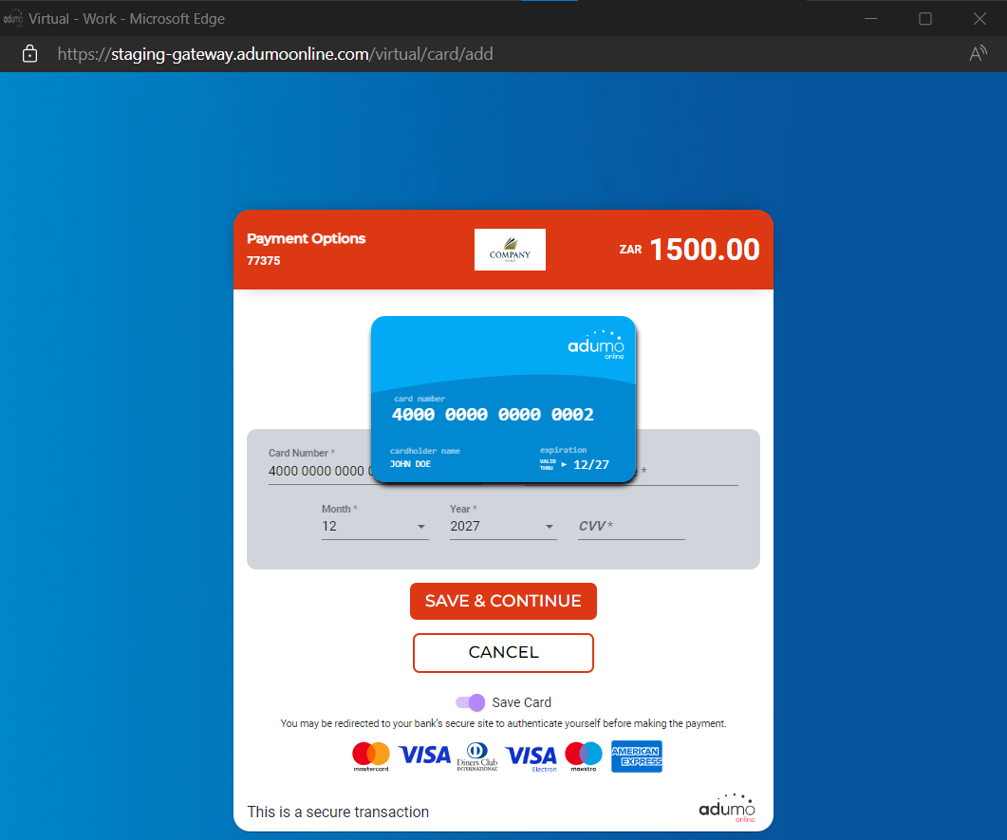
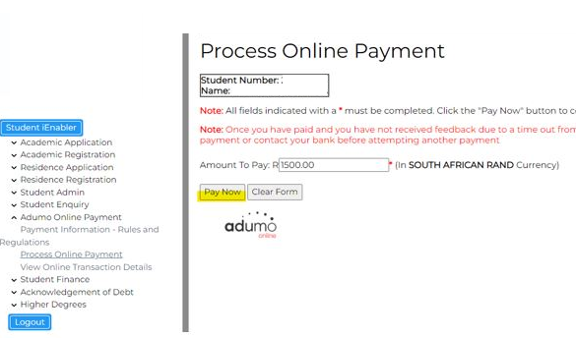
MyGate re-branding to Adumo

Slide 12
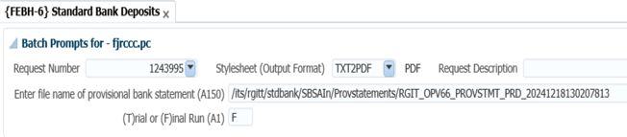
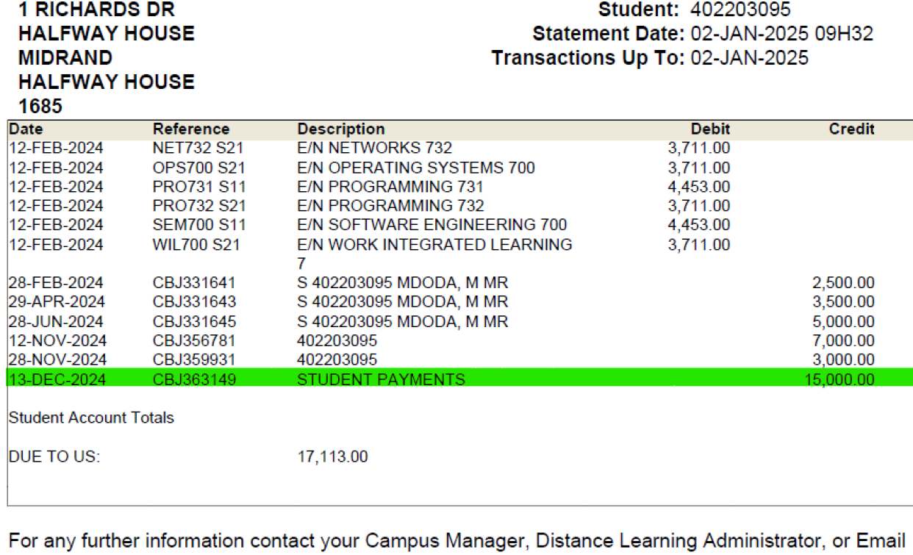
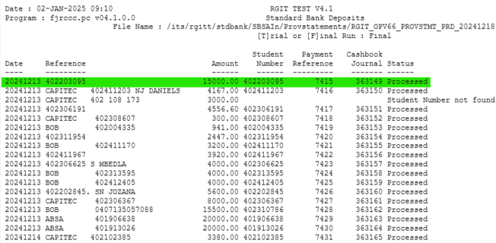
Create Student Deposits using Provisional Statements

Slide 13
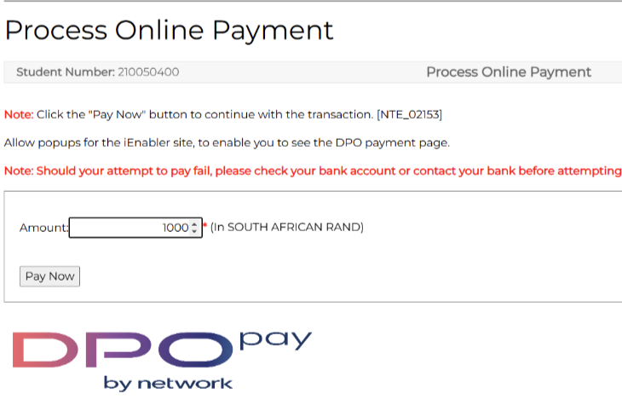
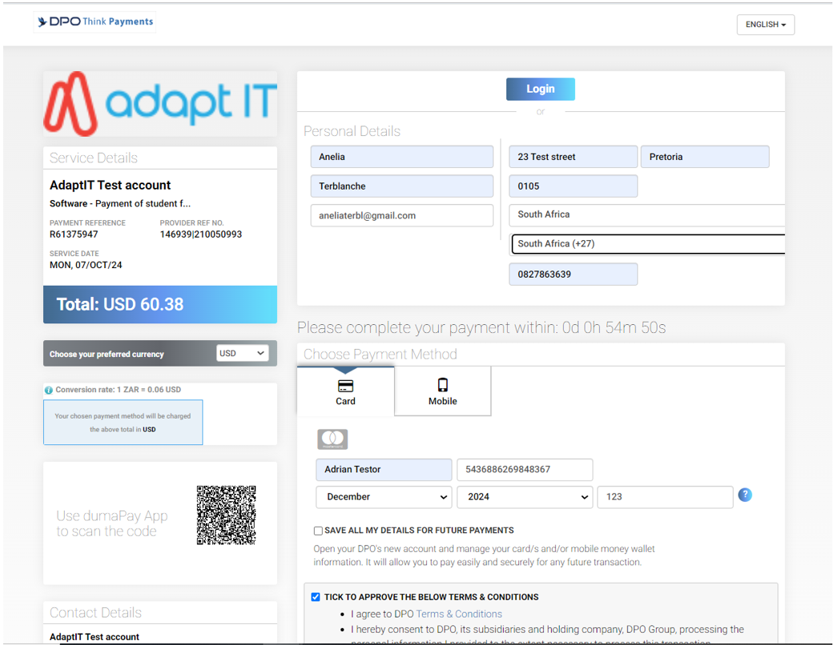
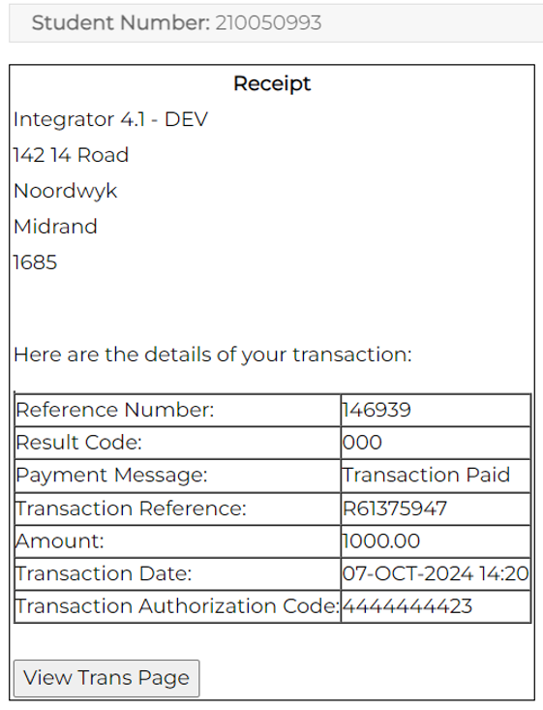
DPO Payment Gateway

Slide 14
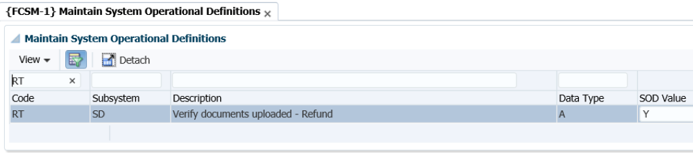
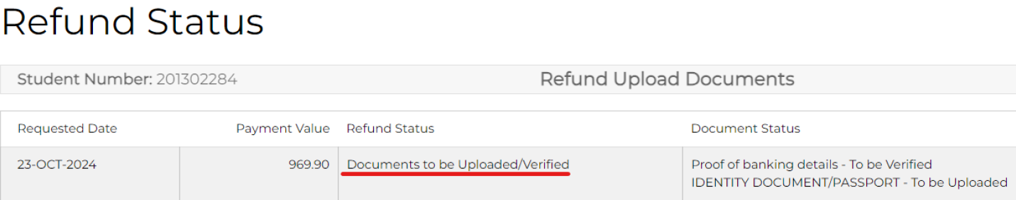
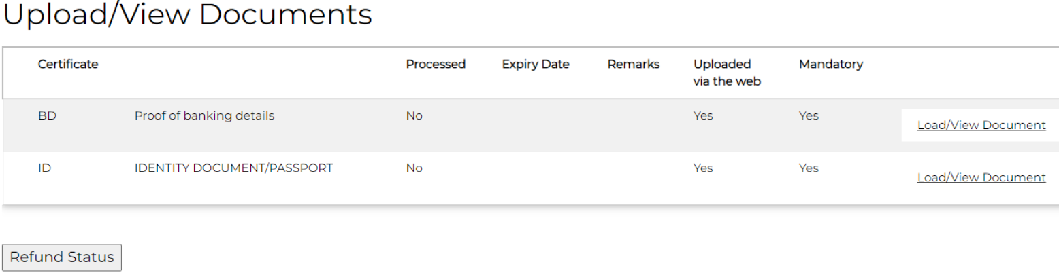
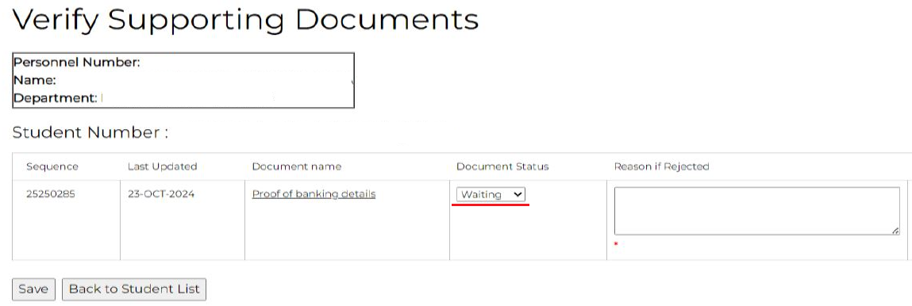
Refunds Documents Verification

Slide 15
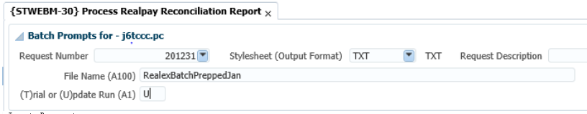
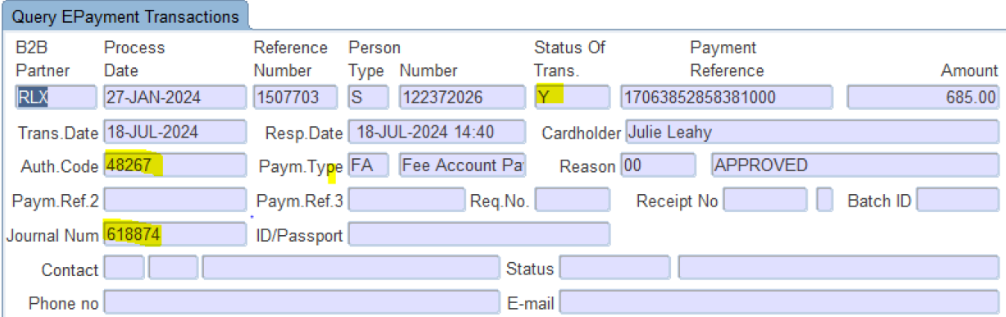
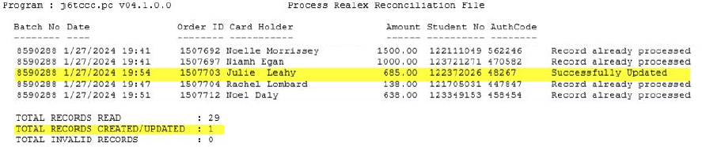
Batch to update the missing Realex transactions

Slide 16
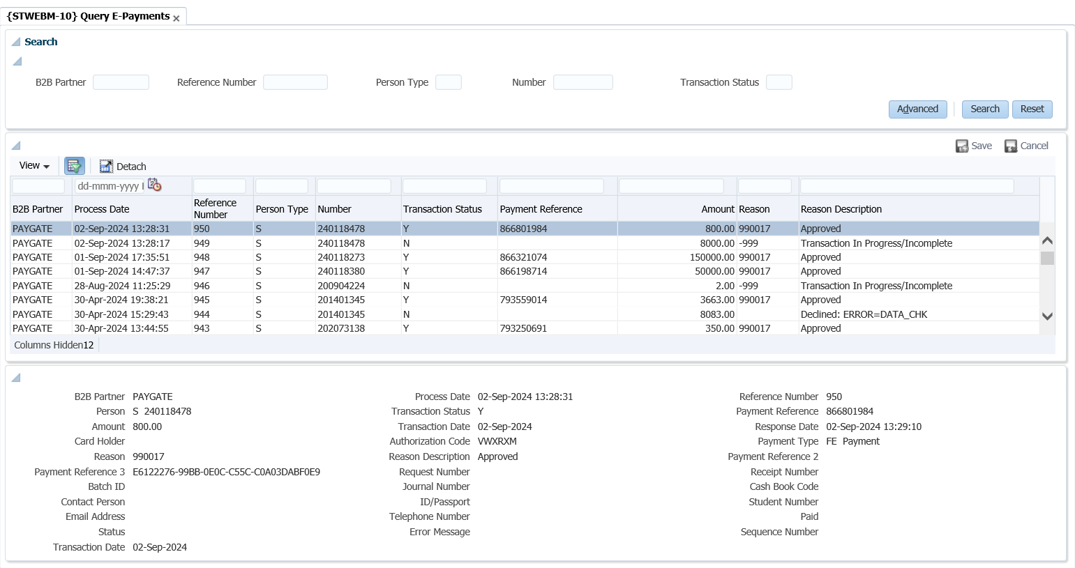
ADF Conversions

Slide 17

Hardening iEnabler Security

Slide 18

Finance Enhancements
Ad-hoc Payments
AR Automation
Send Payment advice on generation of ACB Tape
Reversal of Depreciation {AGRAP-1} Re-write
Enhancements for Assets Maintenance {AOPS-8}
New business function to Query the users that are linked to a specific CC against a specific group code
Enhancements to report {FPMOR2-4}
Jasper view for Partly Ordered Request to display the same detail as {FPMOR2-2}

Slide 19
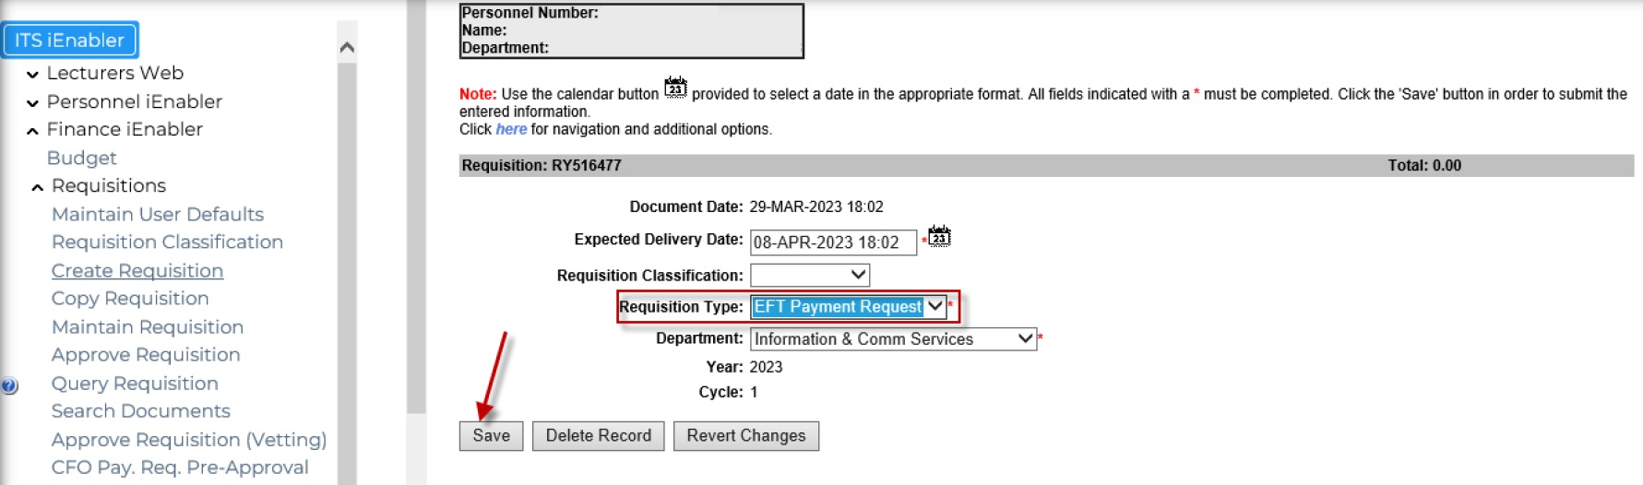
Ad-hoc Payments

Slide 20
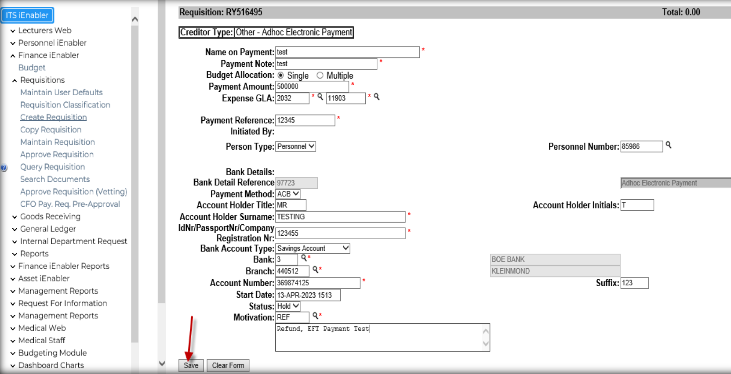
Ad-hoc Payments (Cont.)

Slide 21
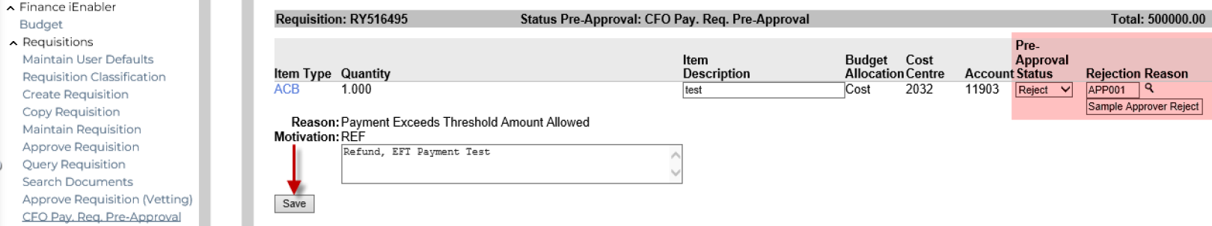
Ad-hoc Payments (Cont.)

Slide 22
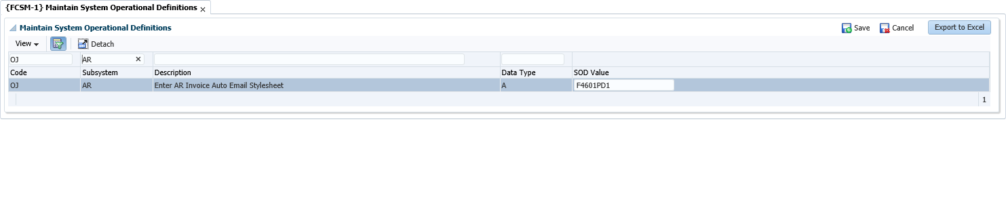

AR Automation

Slide 23
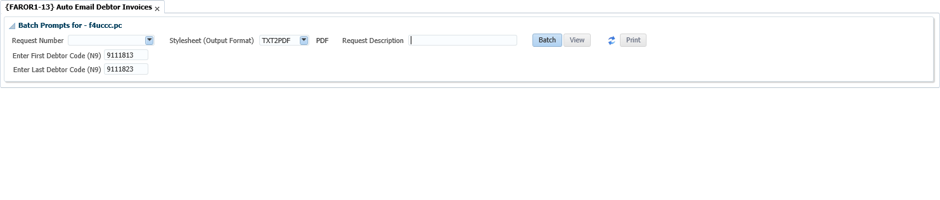
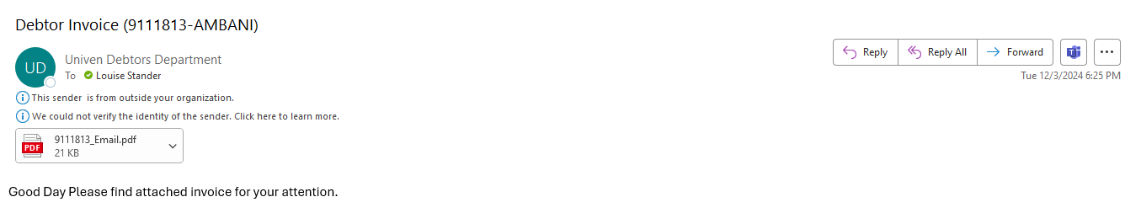
AR Automation (Cont.)

Slide 24
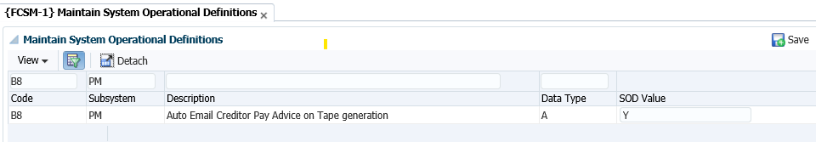
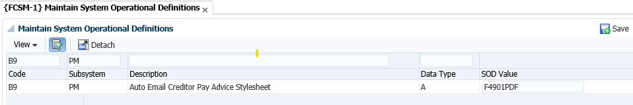
Send Payment advice on generation of ACB Tape

Slide 25
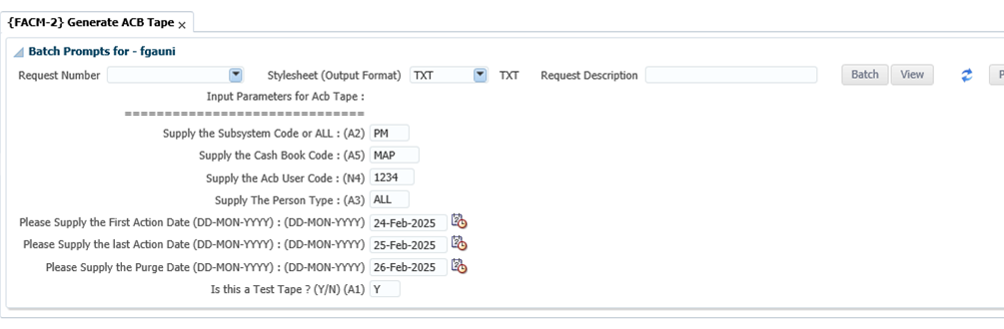
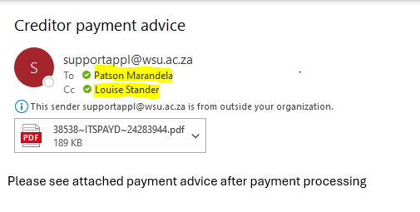
Send Payment advice on generation of ACB Tape (Cont.)

Slide 26
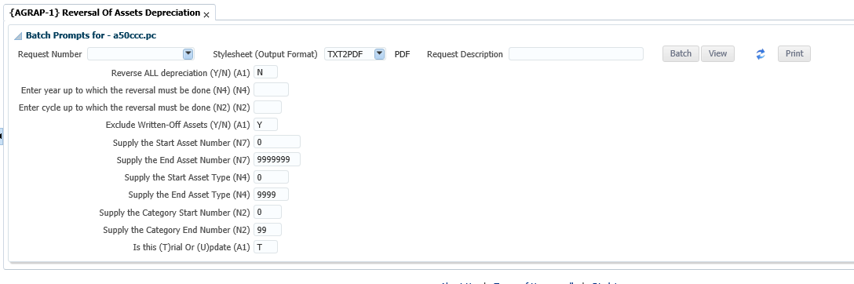
Reversal of Depreciation (Re-write of AGRAP-1)
Note: The program has now been amended that, when the reversal of the depreciation is done – the system does NOT calculate the depreciation, but rather reverse the depreciation as it was recorded up to the date or the year and cycle you specify.

Slide 27
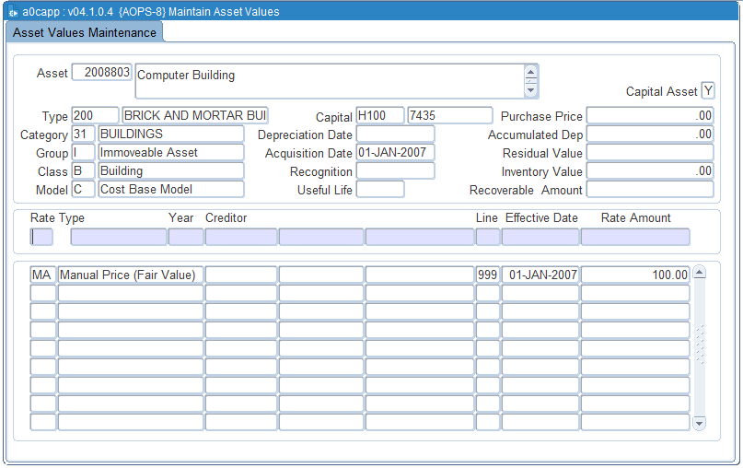
Enhancements for Assets Maintenance {AOPS-8}
Note: The user was unable to add maintenance cost to assets such as building – they will request Adapt IT to do this via a data update. The program has been enhanced to enable the user to add MB record to MA for any additional capital cost to the existing value (i.e. from only the last depreciation date).

Slide 28
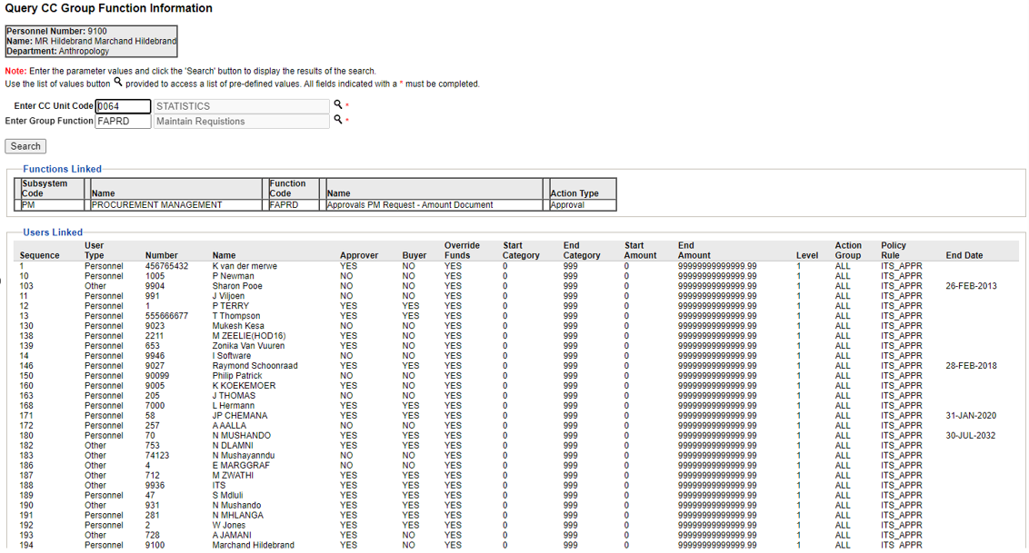
Query the users that are linked to a specific CC

Slide 29
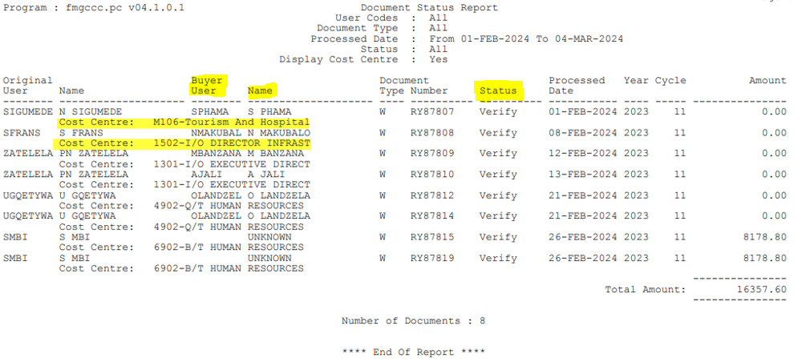
Enhancements to report {FPMOR2-4}

Slide 30
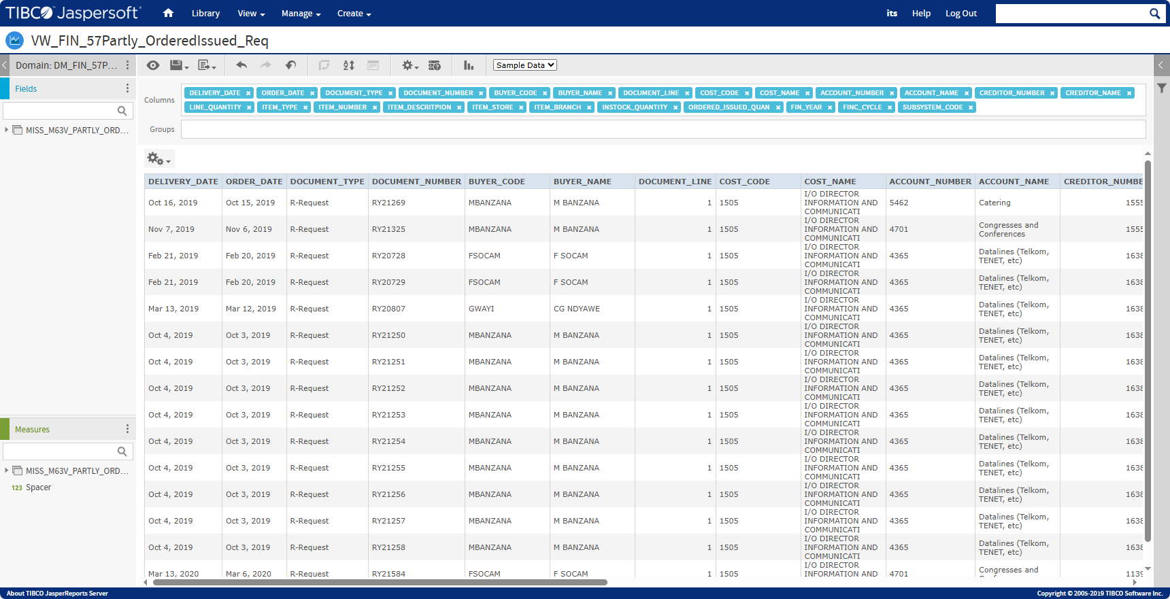
Jasper view for Partly Ordered Request : {FPMOR2-2}

Slide 31

Finance
Roadmap

Slide 32
Finance Roadmap 2024
 | Q1
 | Zapper e-Payment Gateway
 | Send Student Statement via Whatsapp
 | Q2
 | Bulk Assets Upload
 | Assets Verification
 | Q3
 | Batch to update the missing Realex transaction (Irish)
 | Make Student Payment Application standard (Irish)
 | Q4
 | DPO Payment Gateway
 | Vendor API (Supplier Registration Portal)

Slide 33
Finance Roadmap 2025 and Beyond
Assets Verification Scanning app
Asset Verification via iEnabler (SWT)
Forex Payments
Cash Management
Student Funding Management
Supplier Rotation in RFQs (Inc. Contract Manag.)
API for Realex transaction
Q2
Q4
2027
Q1
Q3
2026
Fees API : Infinity
Student Financial Status
(Amount due) : Infinity
VAT Enhancements (Compliance)
Student Accounts (Paygate) : Infinity
Travel Management (Generic API)
Tender Administration (Include Contract Manag.)

Slide 34

What informs the roadmap

Slide 35




What informs the Roadmap
WSP
Workshops
SWT
Research

